Slide 1




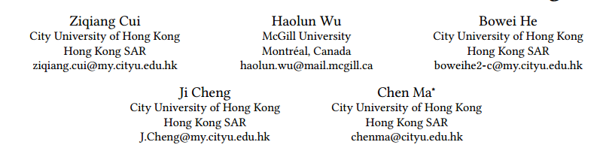





ATAI
Advanced Technique of Artificial Intelligence
ATAI
ChongqingUniversity _{AdvancedTechniqueof}
of Technology Artificial Intelligence
Chongqing University of
Technology
Chongqing University ^{ATAI}
_{of Technology} Advanced Techniqueof
Artificial Intelligence
Chongqing University of Technology
Chongqing University of Technology
Context Matters: Enhancing Sequential Recommendation with
Context-aware Diffusion-based Contrastive Learning
Code : https://github.com/ziqiangcui/CaDiRec.
—— CIKM’2024
2024.11.14 • ChongQing
Reported by YaoYao Zhang
1

Slide 2
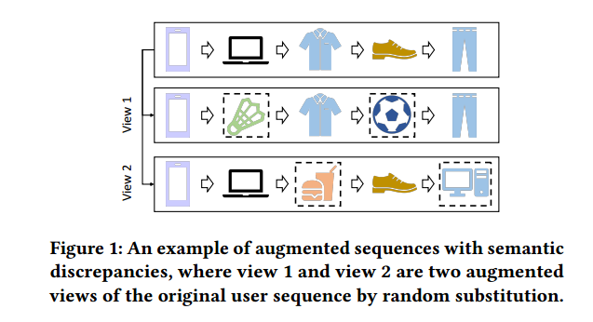
ATAI
Advanced Technique of Artificial Intelligence
ATAI
ChongqingUniversity _{AdvancedTechniqueof}
of Technology Artificial Intelligence
Chongqing University of
Technology
Chongqing University ^{ATAI}
_{of Technology} Advanced Techniqueof
Artificial Intelligence
Chongqing University of Technology
Chongqing University of Technology
Motivation
Most existing approaches generate augmented views of the same user sequence through random augmentation. However, these methods often neglect the rationality of the augmented samples. Random augmentation can disrupt the semantic information and interest evolution patterns inherent in the original user sequences. To address these limitations, we propose the CaDiRec. The core idea is to leverage context information to generate more reasonable augmented views

Slide 3
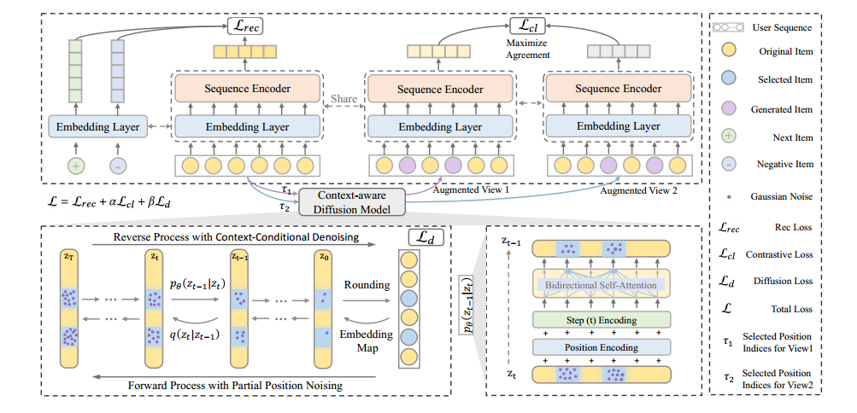
ATAI
Advanced Technique of Artificial Intelligence
ATAI
ChongqingUniversity _{AdvancedTechniqueof}
of Technology Artificial Intelligence
Chongqing University of
Technology
Chongqing University ^{ATAI}
_{of Technology} Advanced Techniqueof
Artificial Intelligence
Chongqing University of Technology
Chongqing University of Technology
Overview

Slide 4

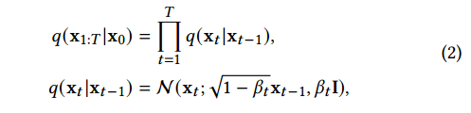
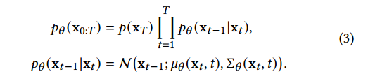
ATAI
Advanced Technique of Artificial Intelligence
ATAI
ChongqingUniversity _{AdvancedTechniqueof}
of Technology Artificial Intelligence
Chongqing University of
Technology
Chongqing University ^{ATAI}
_{of Technology} Advanced Techniqueof
Artificial Intelligence
Chongqing University of Technology
Chongqing University of Technology
Preliminary
Forward process
Reverse process

Slide 5
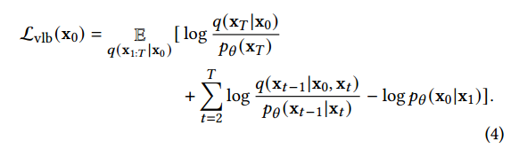

ATAI
Advanced Technique of Artificial Intelligence
ATAI
ChongqingUniversity _{AdvancedTechniqueof}
of Technology Artificial Intelligence
Chongqing University of
Technology
Chongqing University ^{ATAI}
_{of Technology} Advanced Techniqueof
Artificial Intelligence
Chongqing University of Technology
Chongqing University of Technology
Preliminary

Slide 6

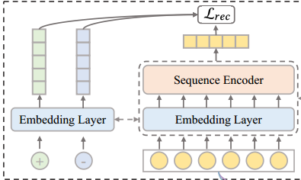

ATAI
Advanced Technique of Artificial Intelligence
ATAI
ChongqingUniversity _{AdvancedTechniqueof}
of Technology Artificial Intelligence
Chongqing University of
Technology
Chongqing University ^{ATAI}
_{of Technology} Advanced Techniqueof
Artificial Intelligence
Chongqing University of Technology
Chongqing University of Technology
Method

Slide 7
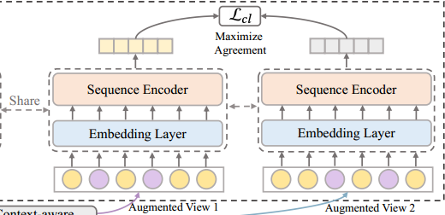

ATAI
Advanced Technique of Artificial Intelligence
ATAI
ChongqingUniversity _{AdvancedTechniqueof}
of Technology Artificial Intelligence
Chongqing University of
Technology
Chongqing University ^{ATAI}
_{of Technology} Advanced Techniqueof
Artificial Intelligence
Chongqing University of Technology
Chongqing University of Technology
Method

Slide 8
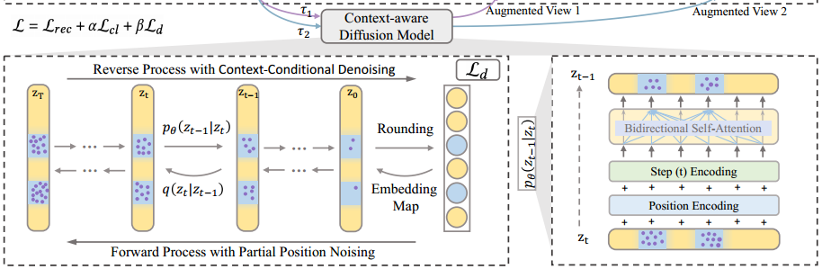



ATAI
Advanced Technique of Artificial Intelligence
ATAI
ChongqingUniversity _{AdvancedTechniqueof}
of Technology Artificial Intelligence
Chongqing University of
Technology
Chongqing University ^{ATAI}
_{of Technology} Advanced Techniqueof
Artificial Intelligence
Chongqing University of Technology
Chongqing University of Technology
Method

Slide 9


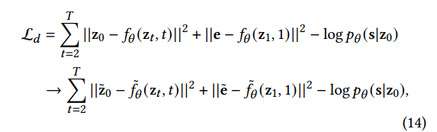
ATAI
Advanced Technique of Artificial Intelligence
ATAI
ChongqingUniversity _{AdvancedTechniqueof}
of Technology Artificial Intelligence
Chongqing University of
Technology
Chongqing University ^{ATAI}
_{of Technology} Advanced Techniqueof
Artificial Intelligence
Method
Chongqing University of Technology
Chongqing University of Technology

Slide 10
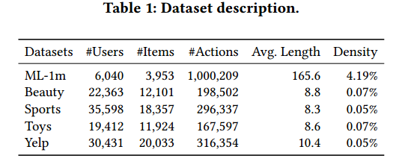
ATAI
Advanced Technique of Artificial Intelligence
ATAI
ChongqingUniversity _{AdvancedTechniqueof}
of Technology Artificial Intelligence
Chongqing University of
Technology
Chongqing University ^{ATAI}
_{of Technology} Advanced Techniqueof
Artificial Intelligence
Chongqing University of Technology
Chongqing University of Technology
Experiments

Slide 11
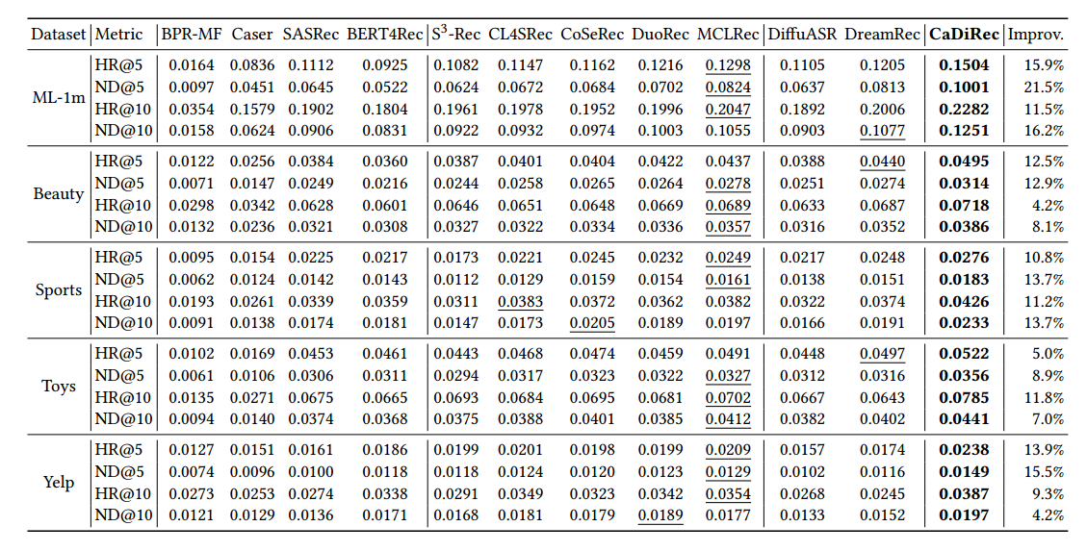
ATAI
Advanced Technique of Artificial Intelligence
ATAI
ChongqingUniversity _{AdvancedTechniqueof}
of Technology Artificial Intelligence
Chongqing University of
Technology
Chongqing University ^{ATAI}
_{of Technology} Advanced Techniqueof
Artificial Intelligence
Experiments
Chongqing University of Technology
Chongqing University of Technology

Slide 12
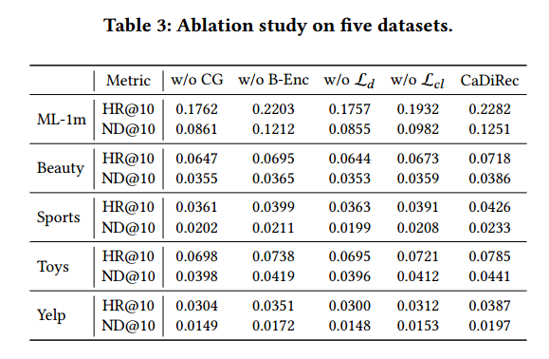
ATAI
Advanced Technique of Artificial Intelligence
ATAI
ChongqingUniversity _{AdvancedTechniqueof}
of Technology Artificial Intelligence
Chongqing University of
Technology
Chongqing University ^{ATAI}
_{of Technology} Advanced Techniqueof
Artificial Intelligence
Chongqing University of Technology
Chongqing University of Technology
Experiments

Slide 13
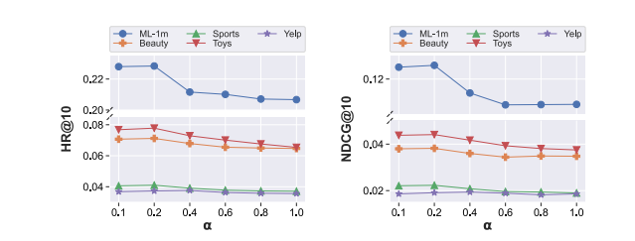
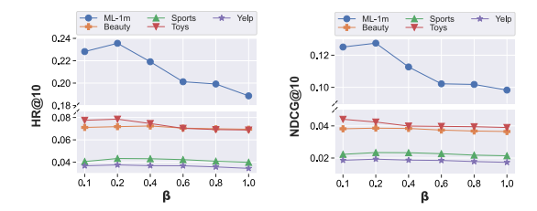
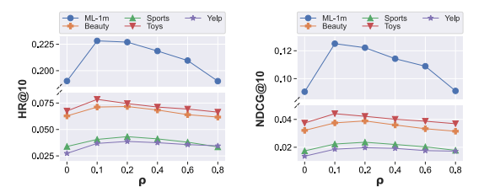
ATAI
Advanced Technique of Artificial Intelligence
ATAI
ChongqingUniversity _{AdvancedTechniqueof}
of Technology Artificial Intelligence
Chongqing University of
Technology
Chongqing University ^{ATAI}
_{of Technology} Advanced Techniqueof
Artificial Intelligence
Chongqing University of Technology
Chongqing University of Technology
Experiments

Slide 14
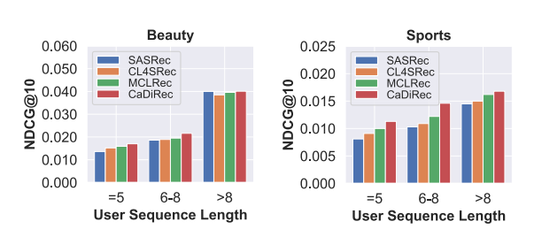
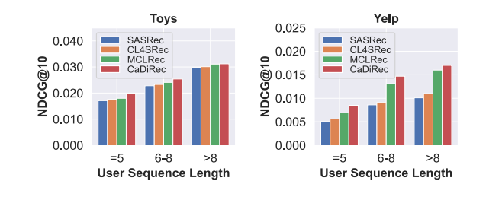
ATAI
Advanced Technique of Artificial Intelligence
ATAI
ChongqingUniversity _{AdvancedTechniqueof}
of Technology Artificial Intelligence
Chongqing University of
Technology
Chongqing University ^{ATAI}
_{of Technology} Advanced Techniqueof
Artificial Intelligence
Chongqing University of Technology
Chongqing University of Technology
Experiments

Slide 15
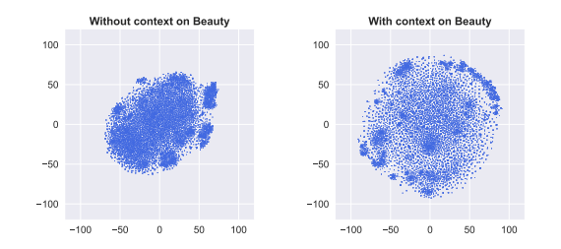
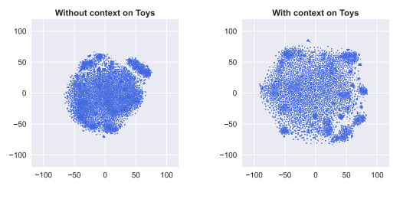
ATAI
Advanced Technique of Artificial Intelligence
ATAI
ChongqingUniversity _{AdvancedTechniqueof}
of Technology Artificial Intelligence
Chongqing University of
Technology
Chongqing University ^{ATAI}
_{of Technology} Advanced Techniqueof
Artificial Intelligence
Chongqing University of Technology
Chongqing University of Technology
Experiments

Slide 16


ATAI
Advanced Technique of Artificial Intelligence
ATAI
ChongqingUniversity _{AdvancedTechniqueof}
of Technology Artificial Intelligence
Chongqing University of
Technology
Chongqing University ^{ATAI}
_{of Technology} Advanced Techniqueof
Artificial Intelligence
Chongqing University of Technology
Chongqing University of Technology
Thanks!

